Slide 1
AN IOT COMPANY – CONNECTED SOLUTIONS

Slide 2
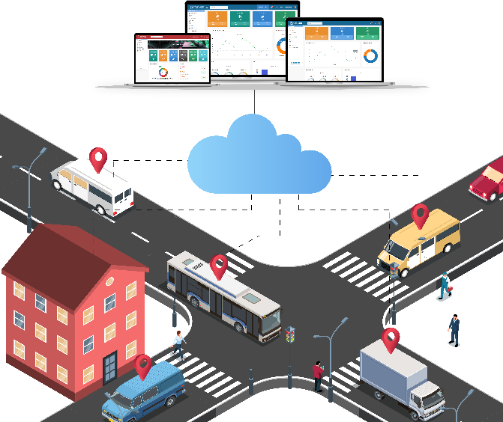
HyperNet IoT Platform
HyperNet IoT Platform is a cloud based IOT secure, scalable solution which connects with million of IOT devices, which becomes the eyes, ears and brain of organizations, and bring the results for multiple type organizations, small or large, and help in operational optimization and decision making.
Following are the Use-Case of HyperNet IoT Platform

Slide 3
Fleet Management System

Slide 4
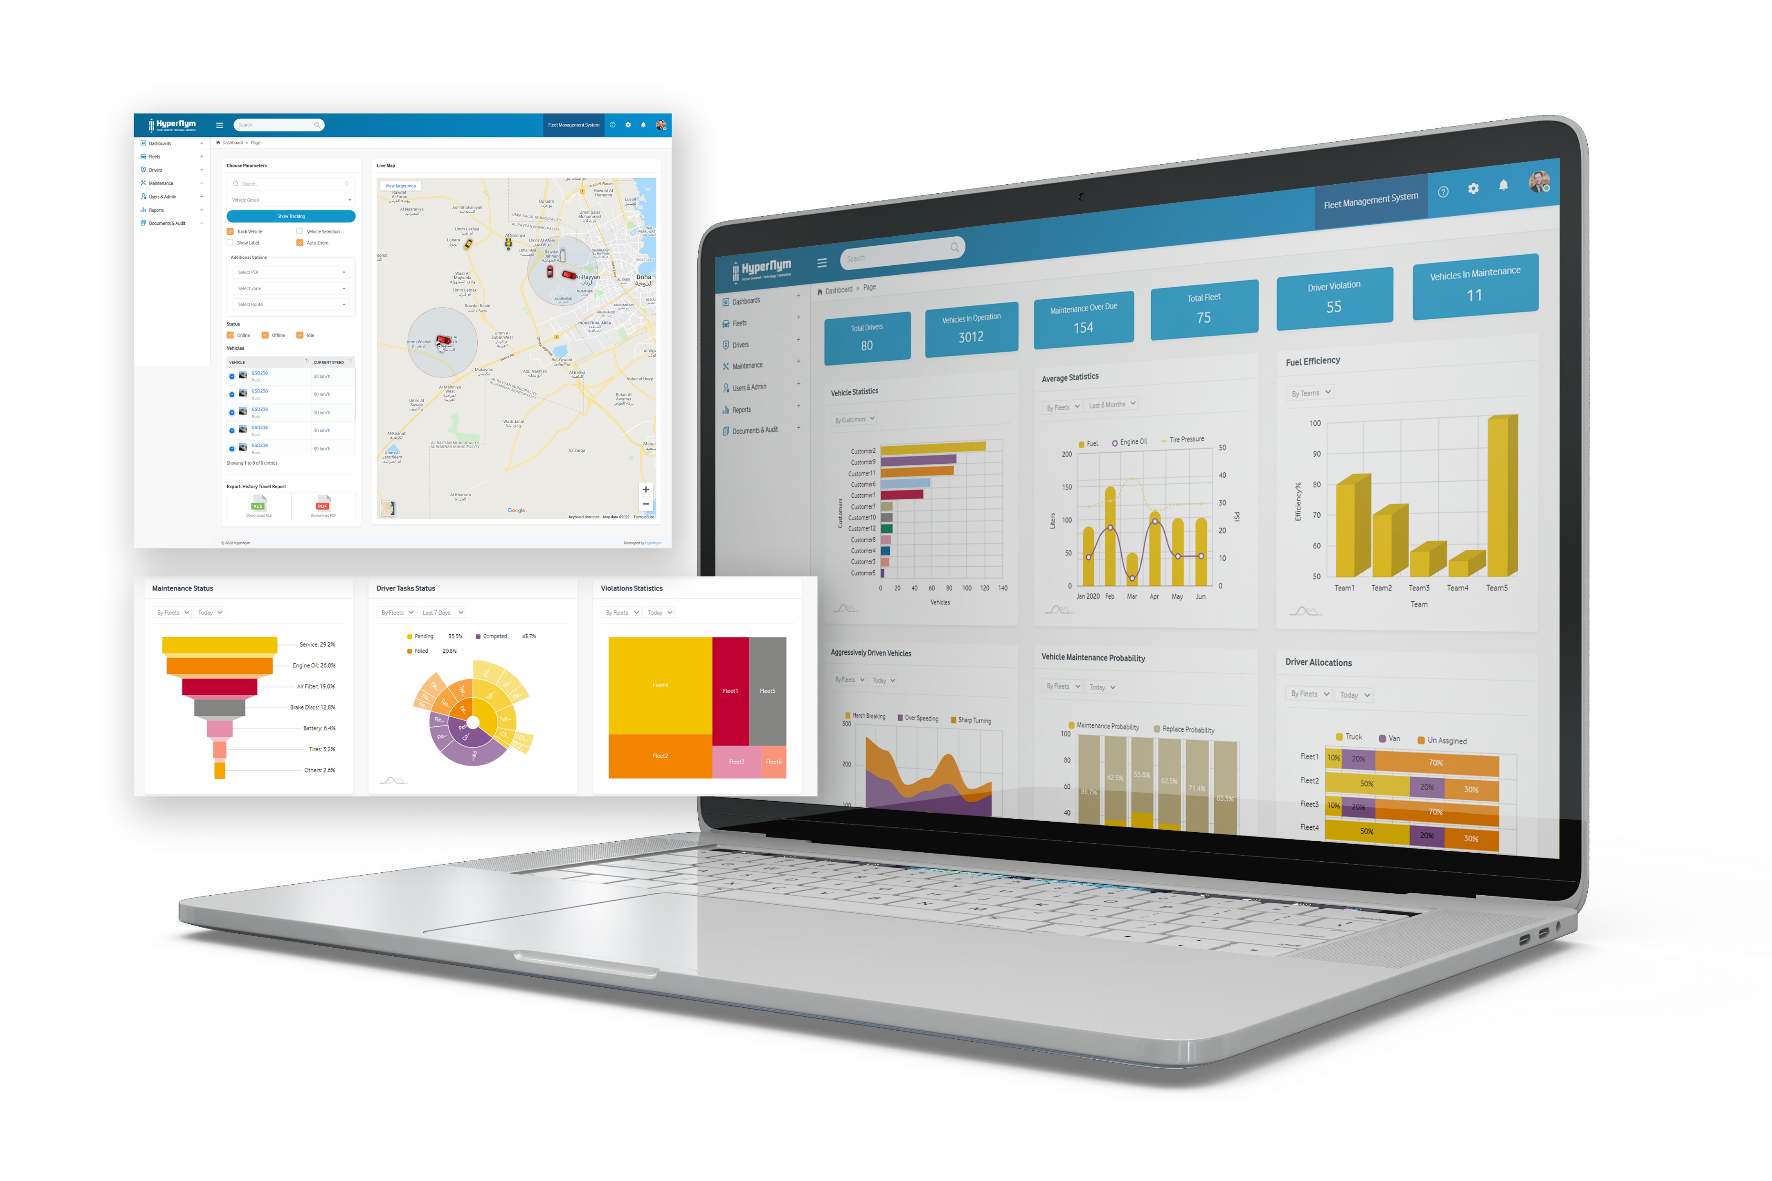
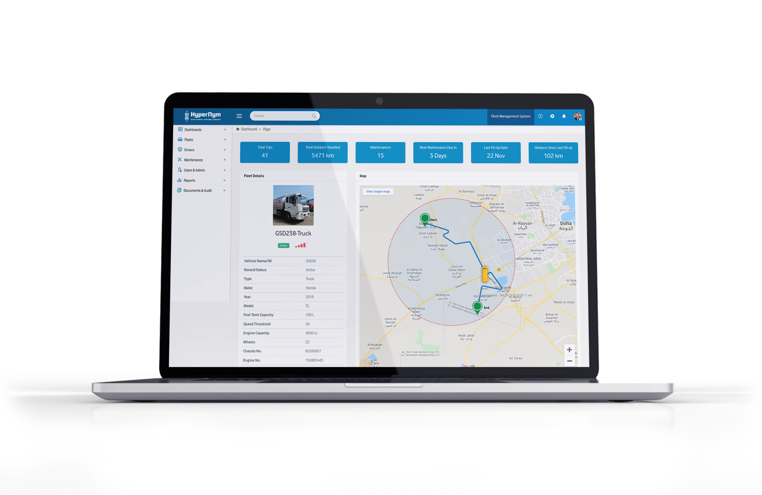
Statistical Dashboards
Individual Vehicle
Tracking

Slide 5
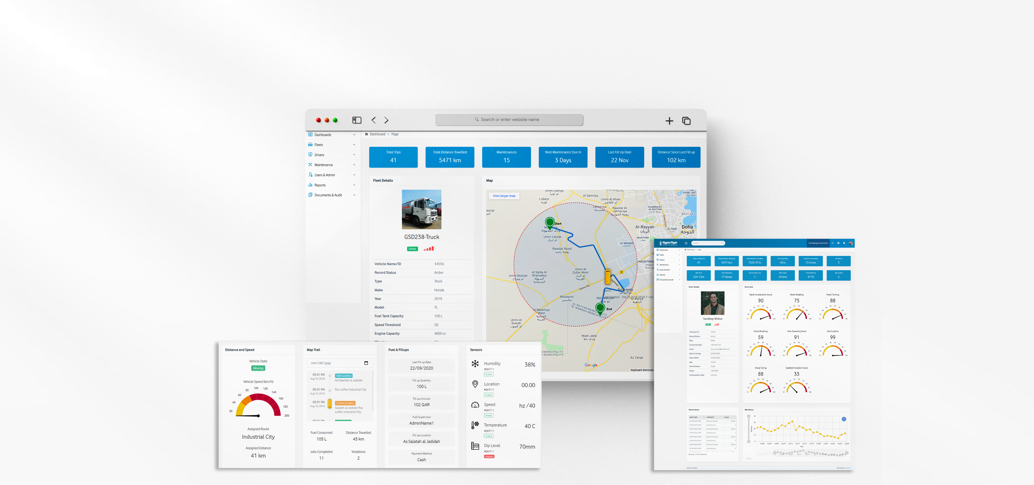
Driver Management
Jobs Management
Predictive Maintenance Management

Slide 6
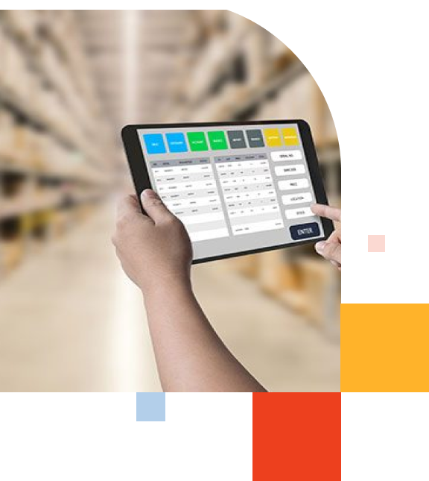
Asset Management System

Slide 7
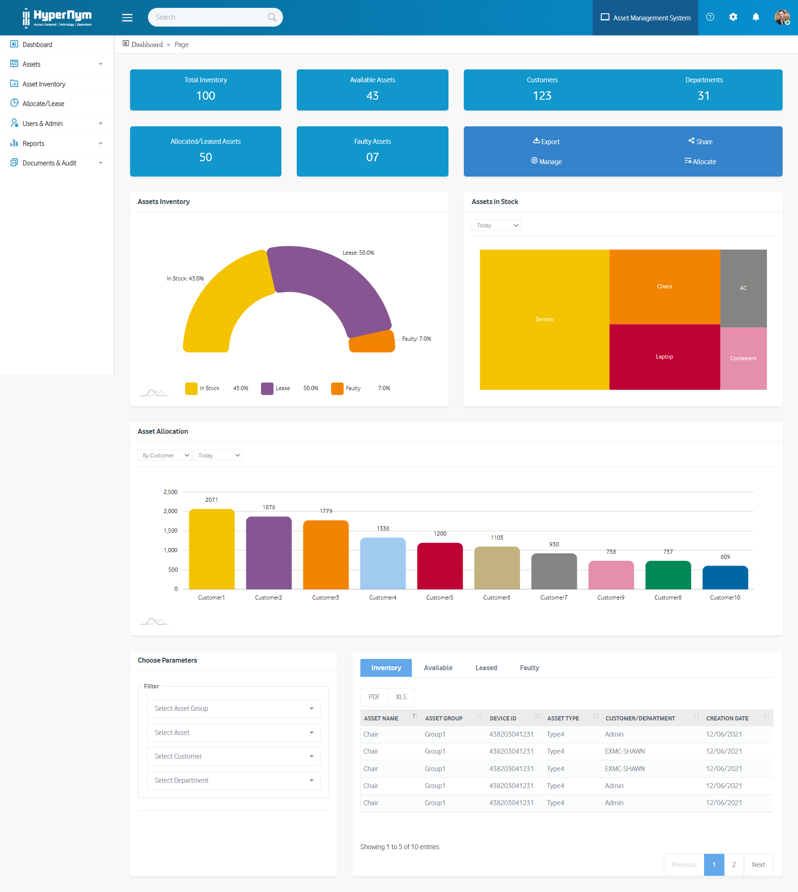
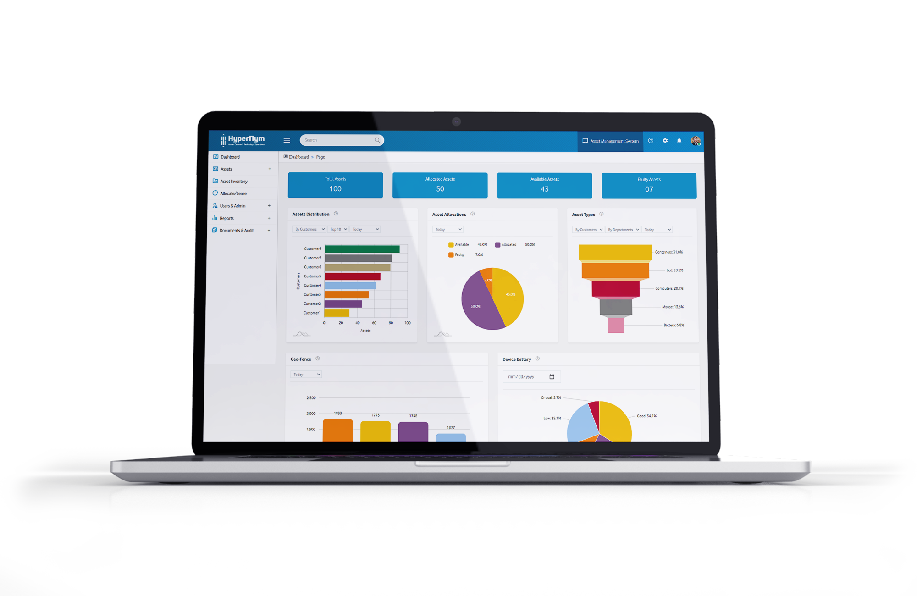
Bird-Eye View Dashboards

Slide 8
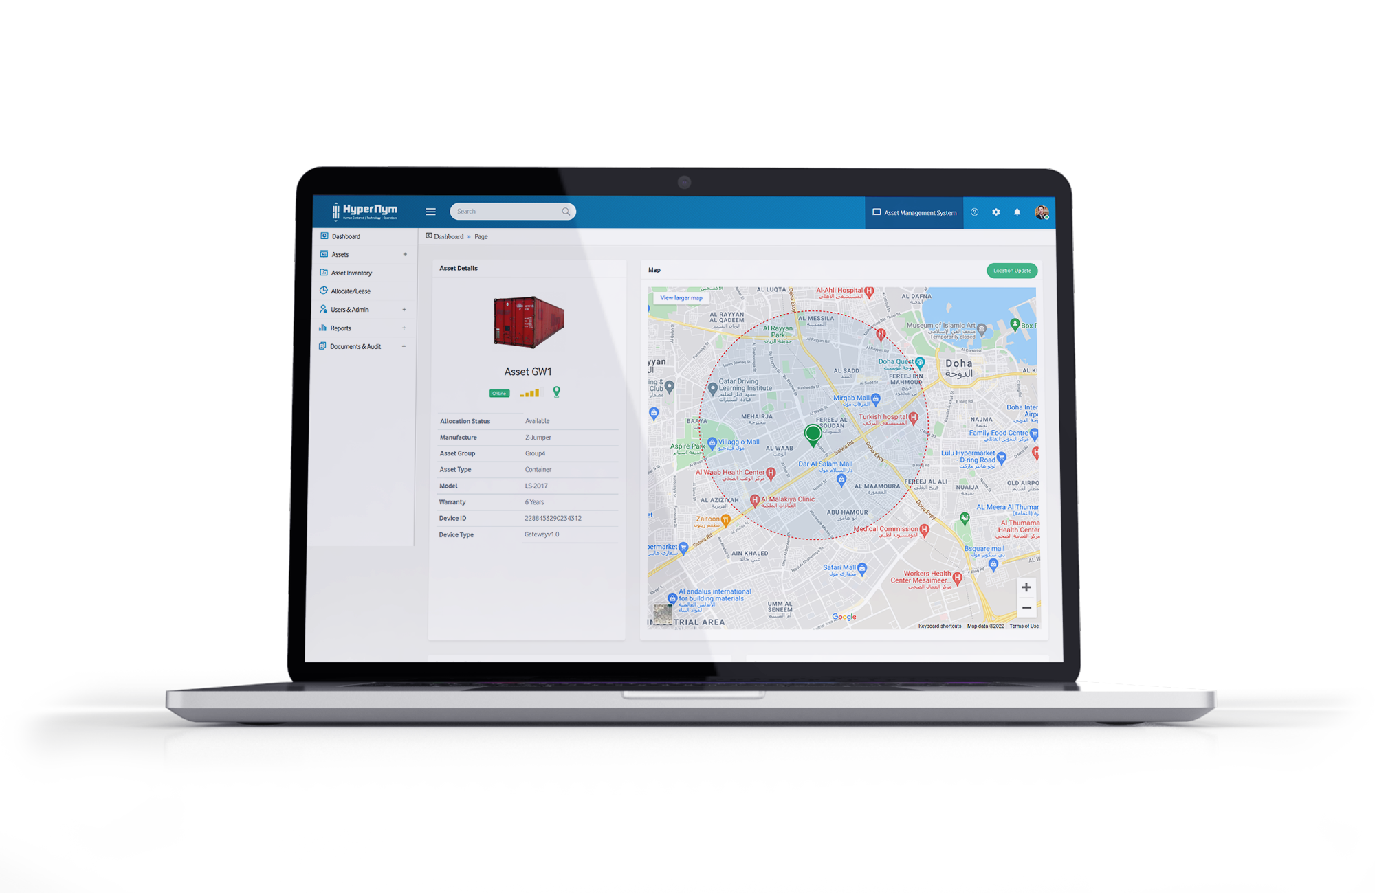
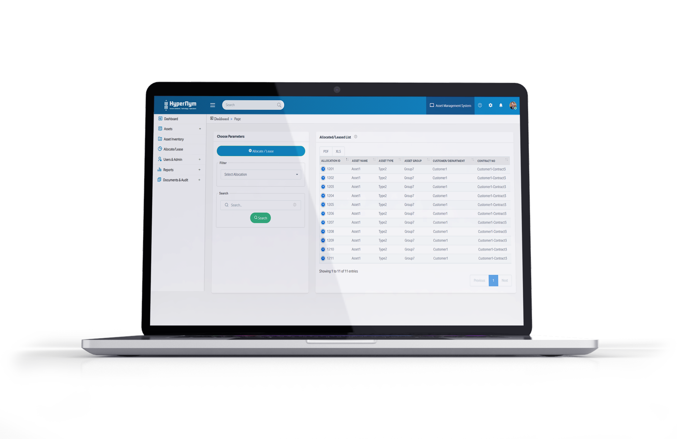
Manage Assets
Assets Allocation/Lease

Slide 9
Smart Surveillance Management
System

Slide 10
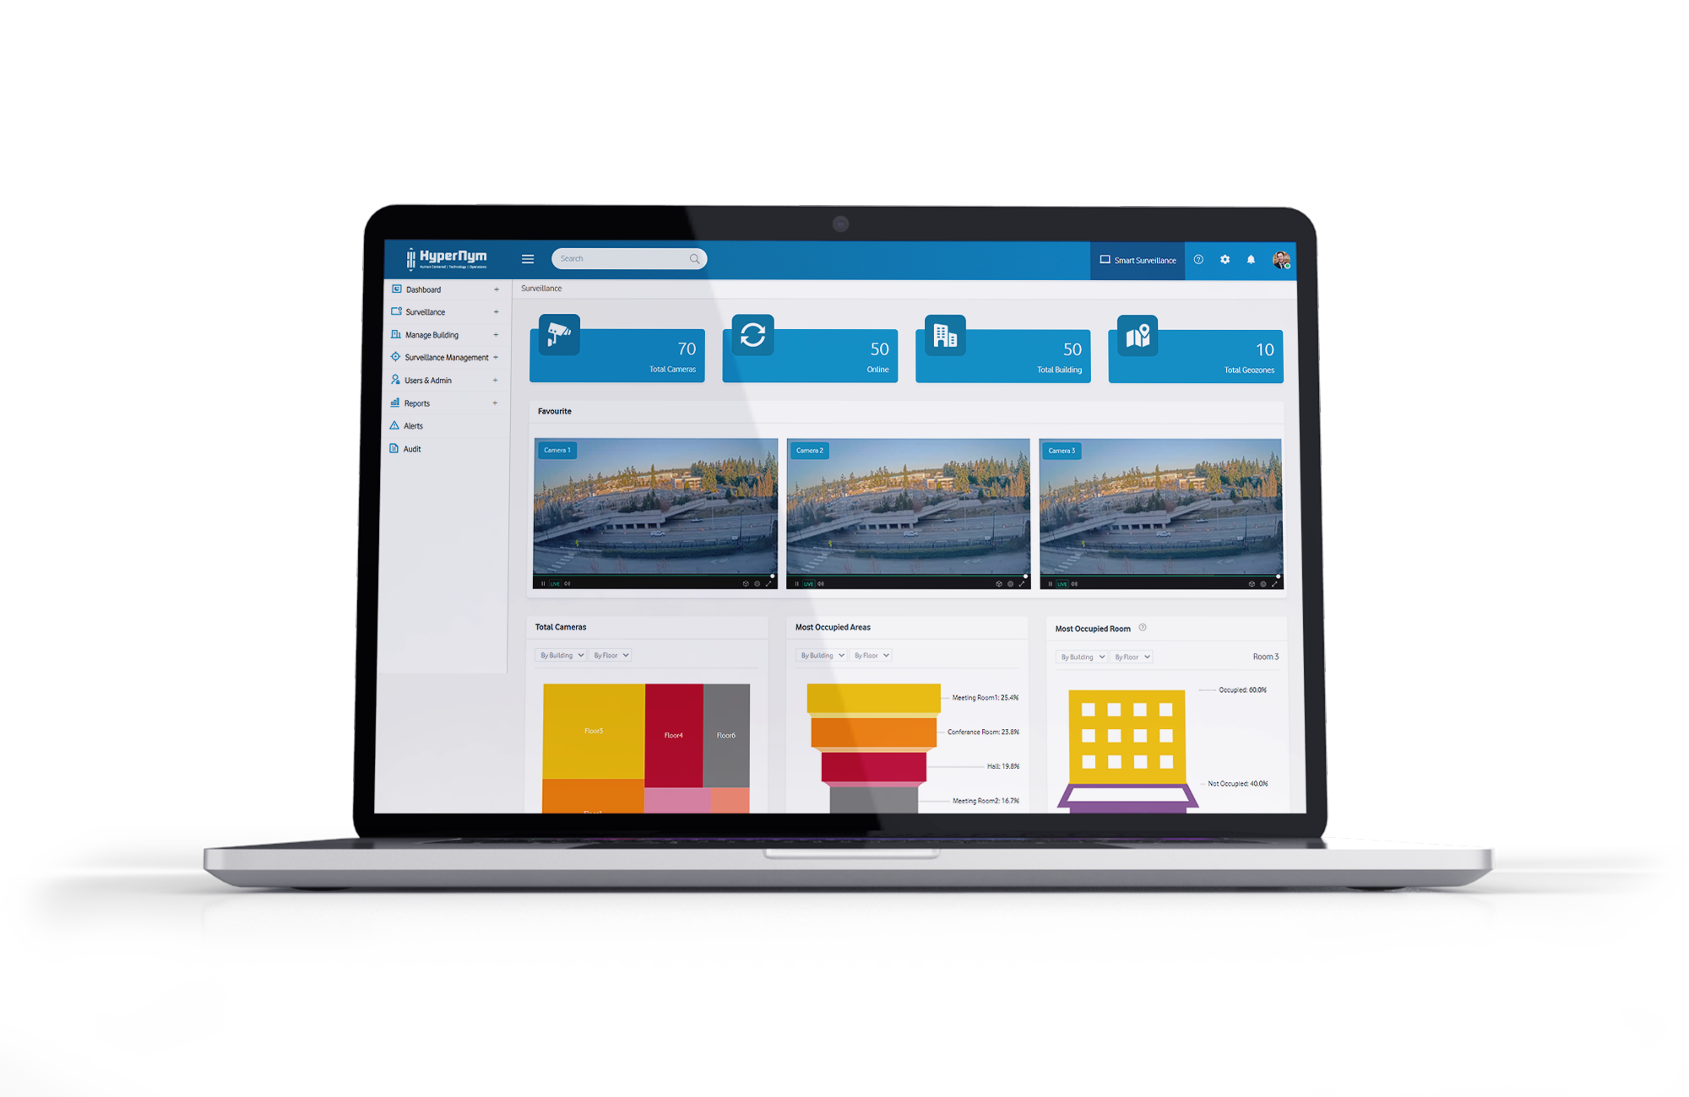
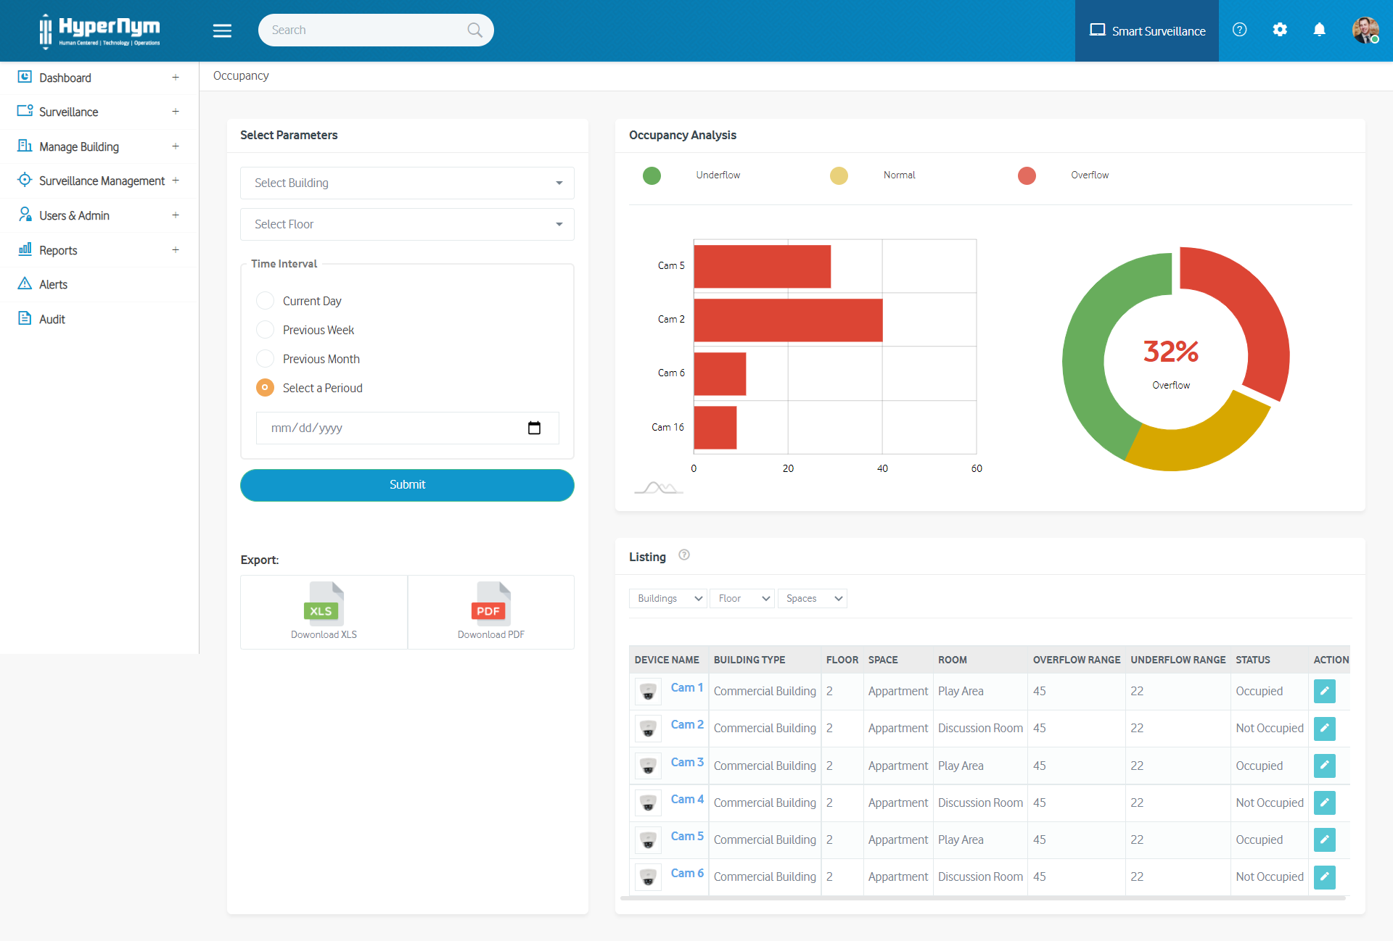
Occupancy
Analysis
Live Dashboards

Slide 11
Smart Building Management
System

Slide 12
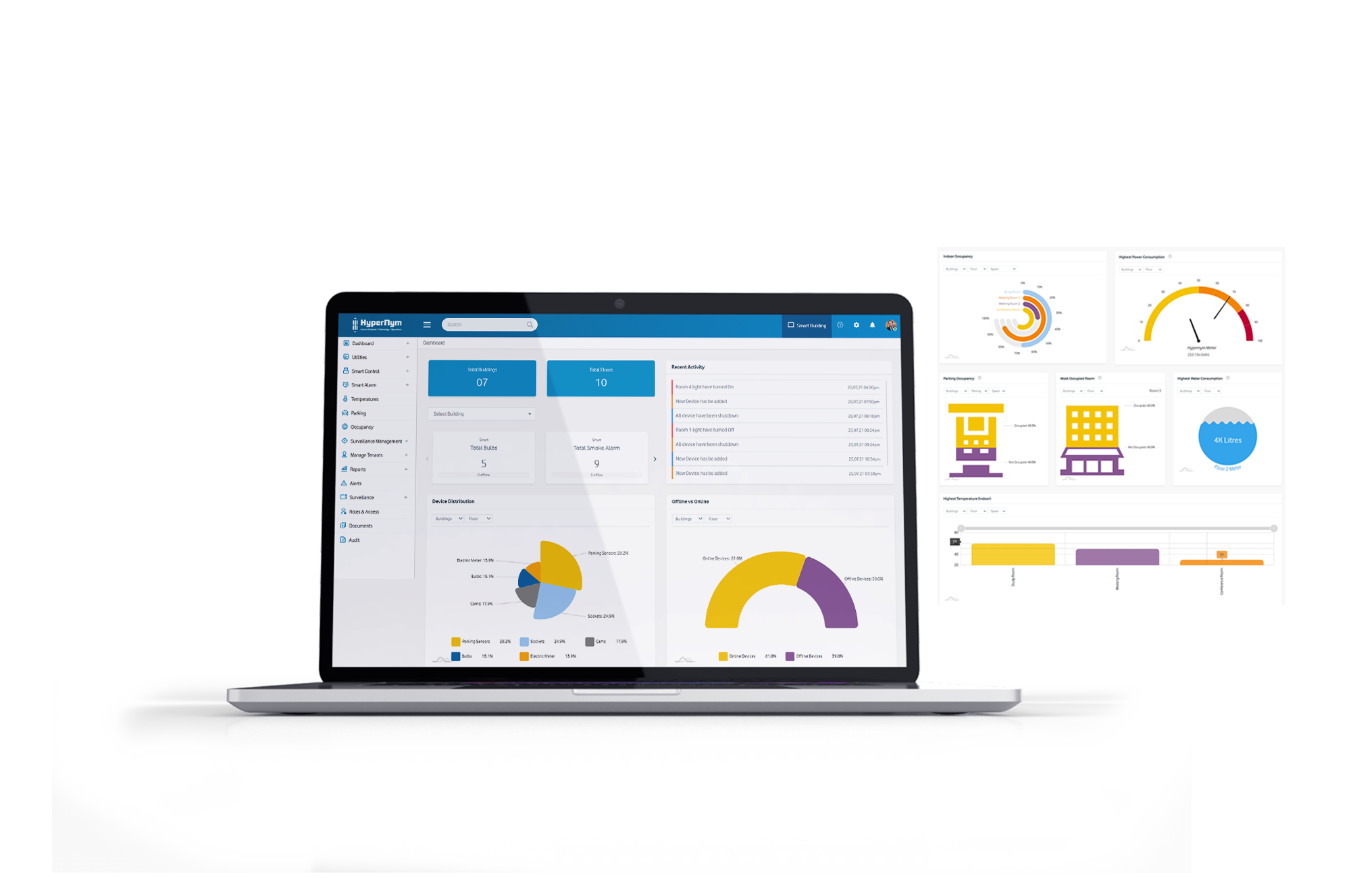
Building-View Dashboards

Slide 13
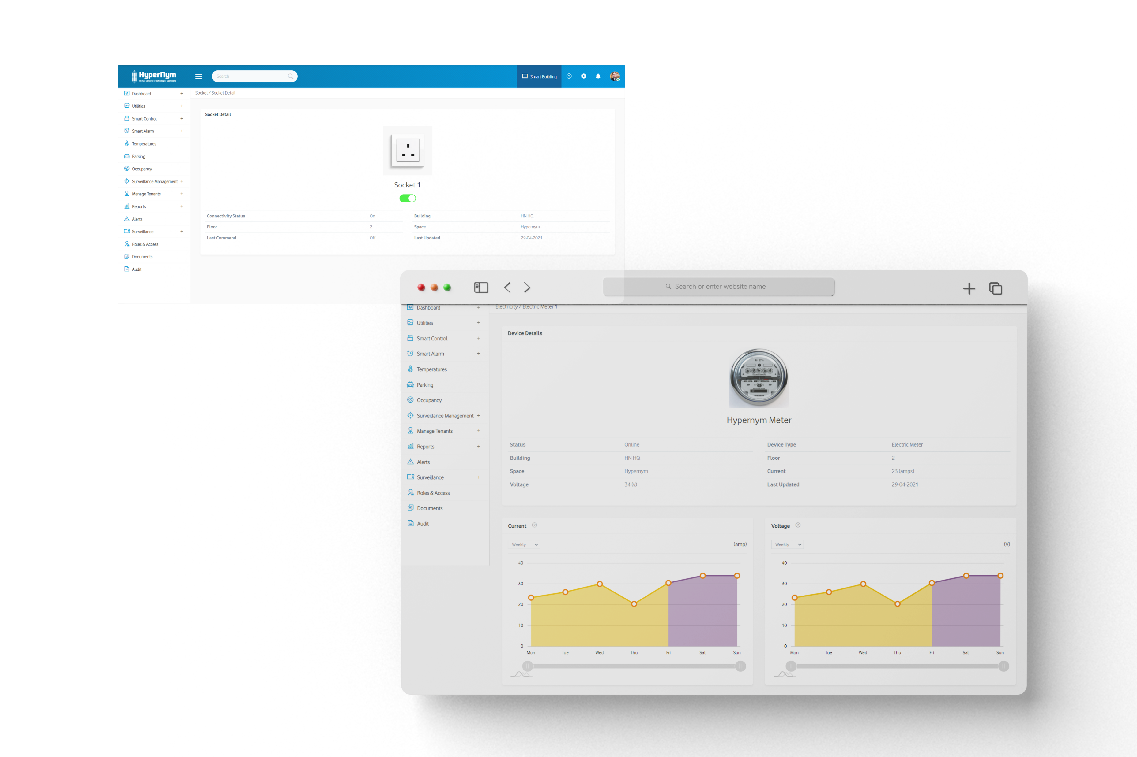
Appliance Management
Utilities
Management

Slide 14
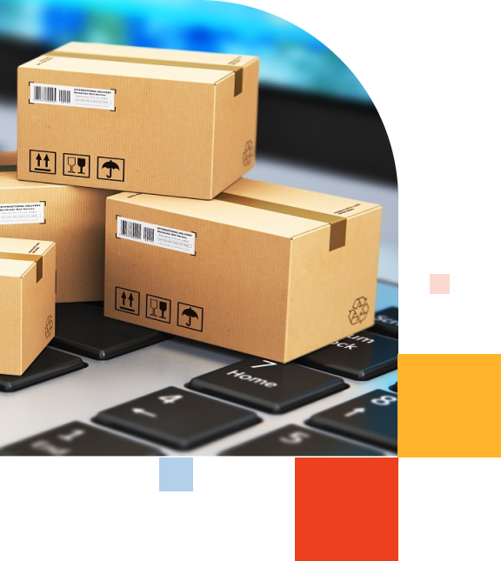
Courier Service Management

Slide 15
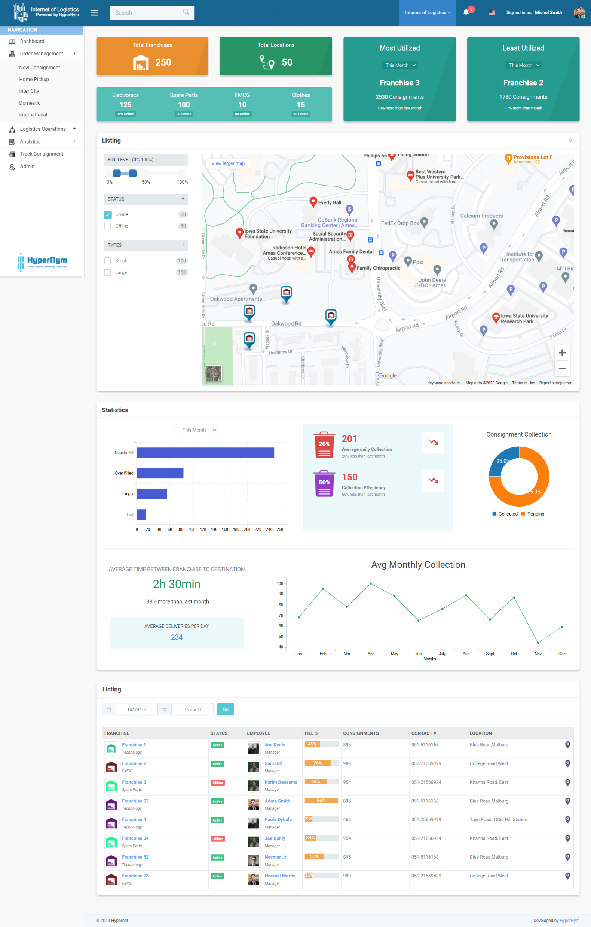
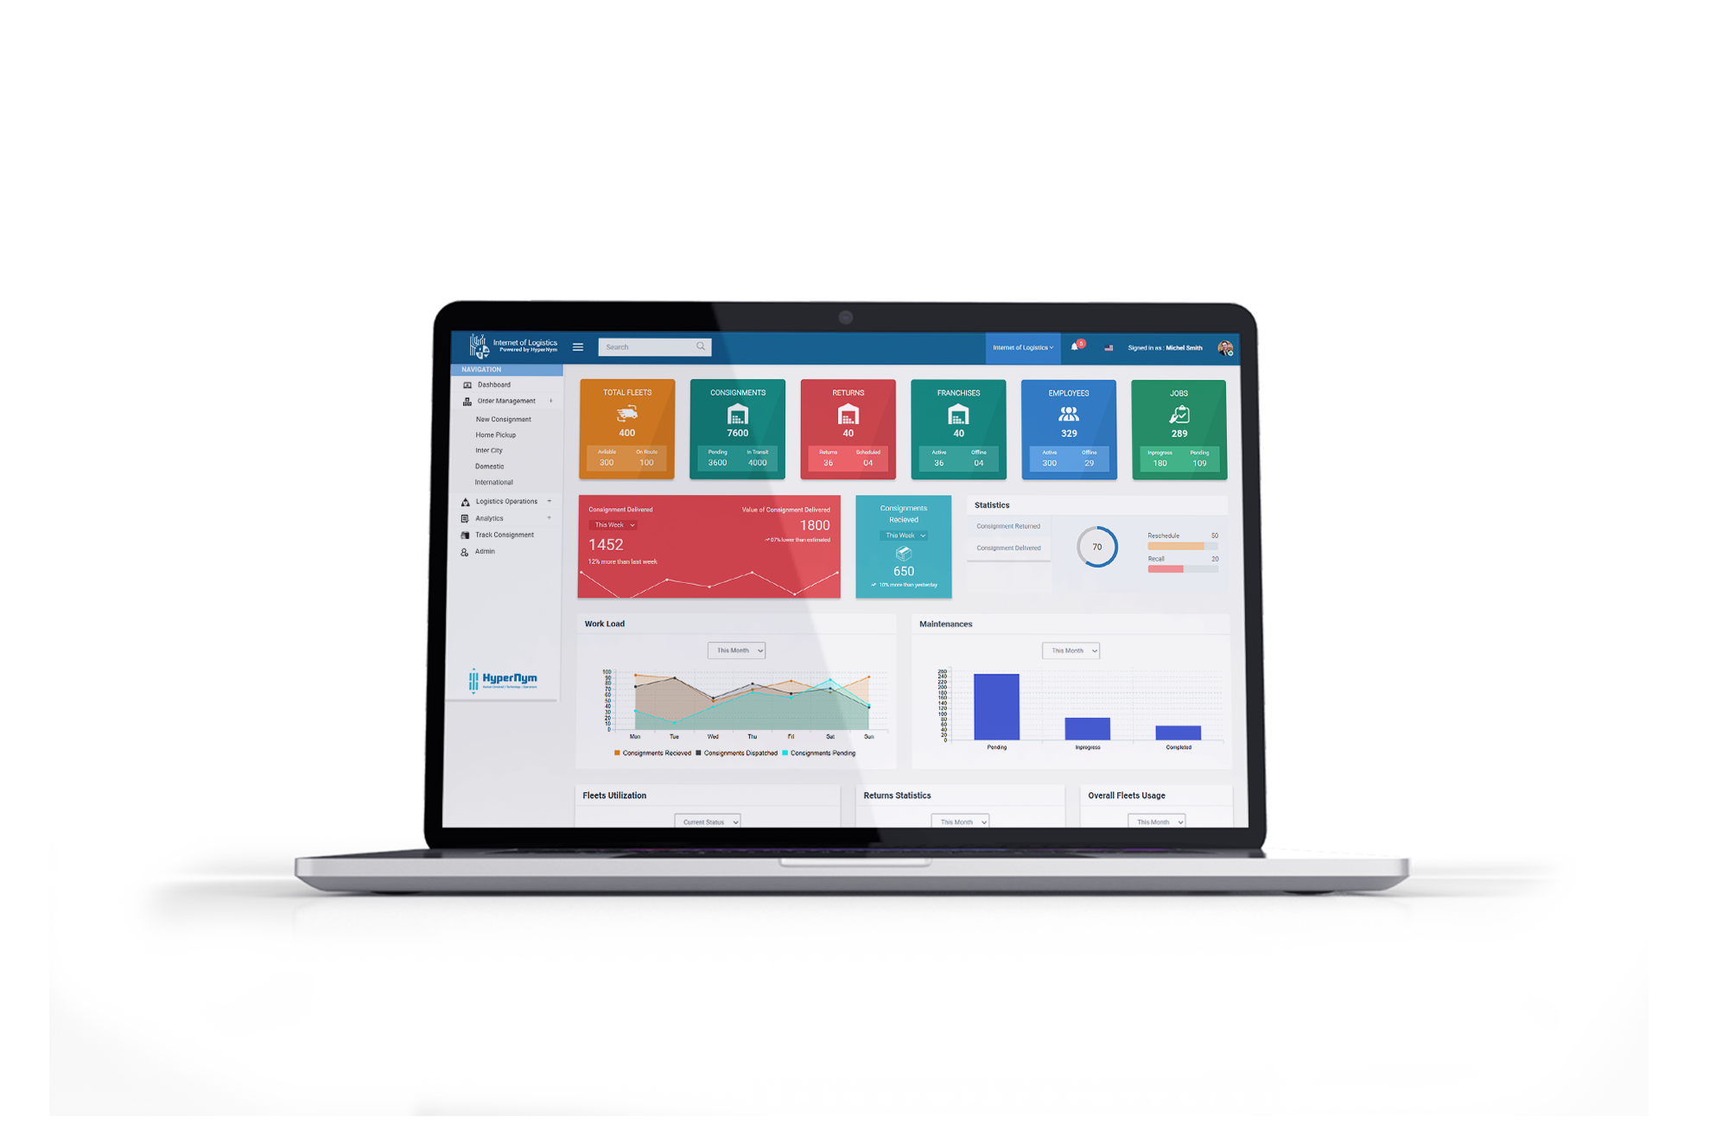
Business View-Dashboards

Slide 16
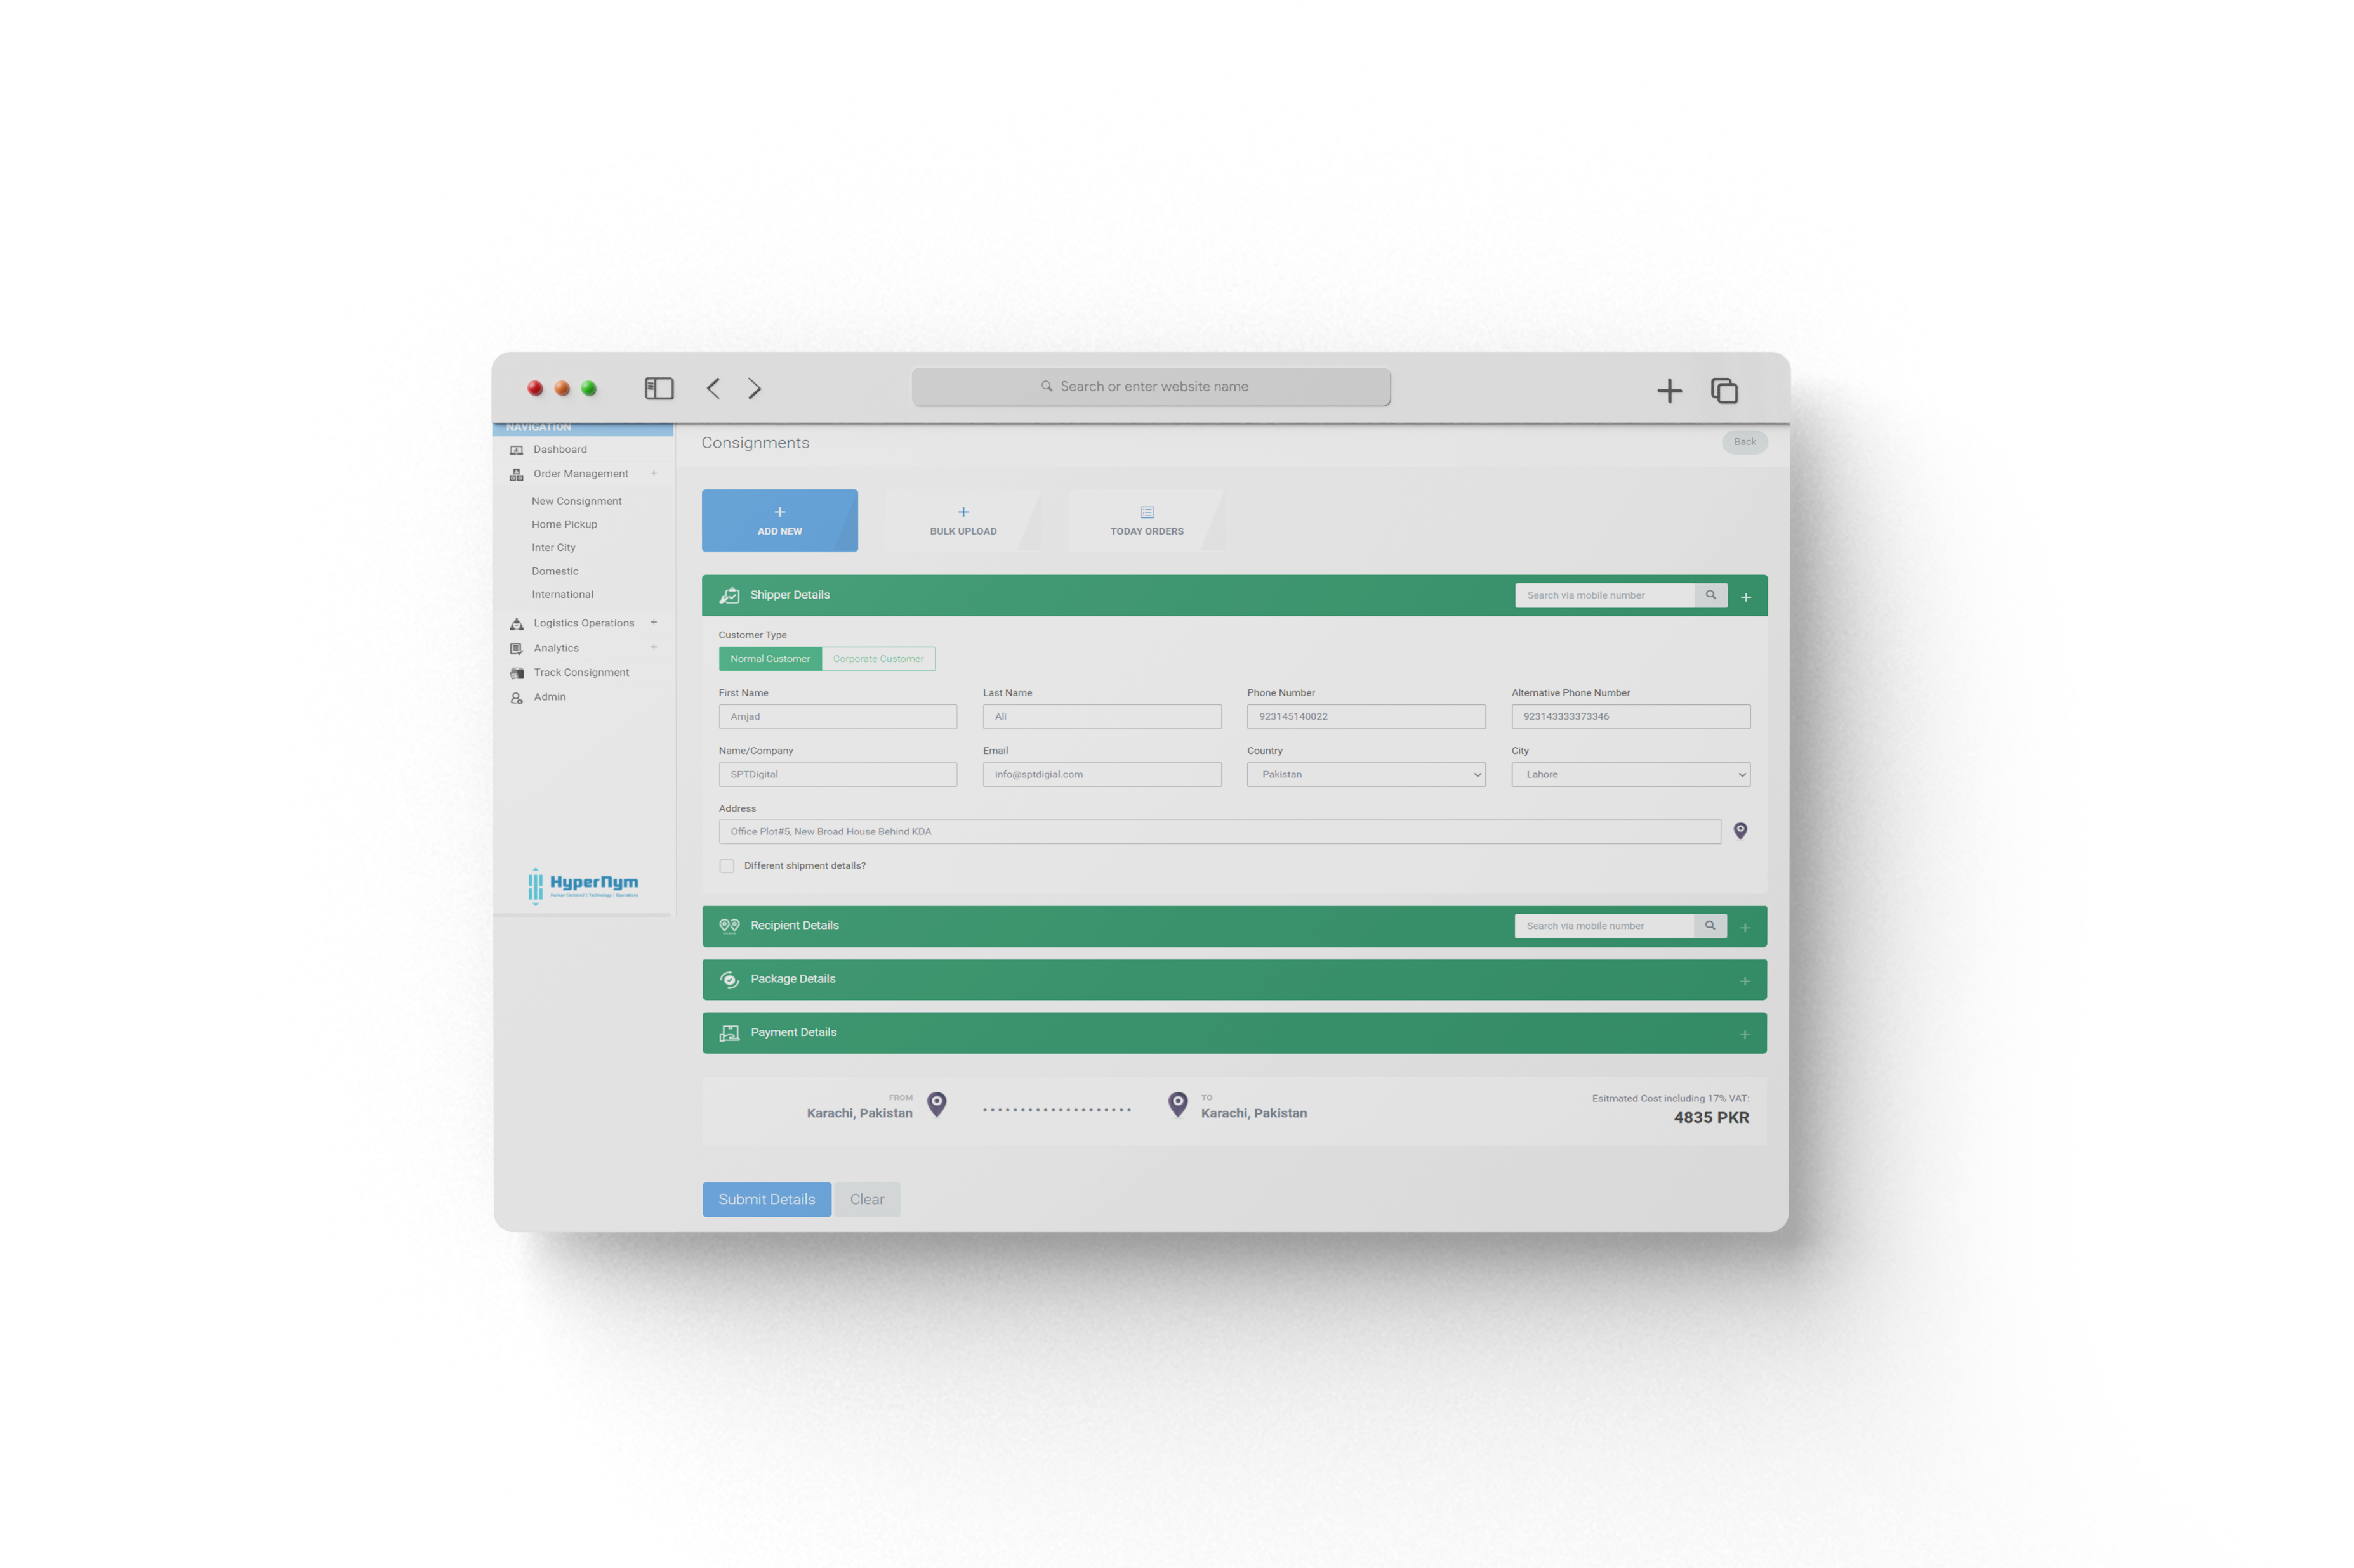
Consignment
Booking

Slide 17
Waste Management
System

Slide 18
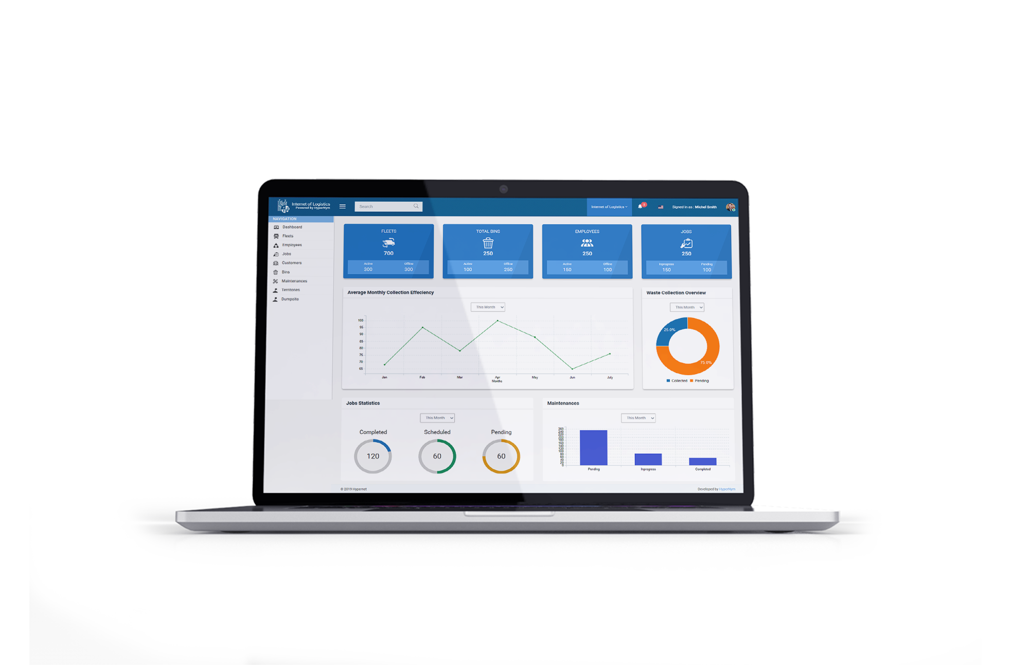
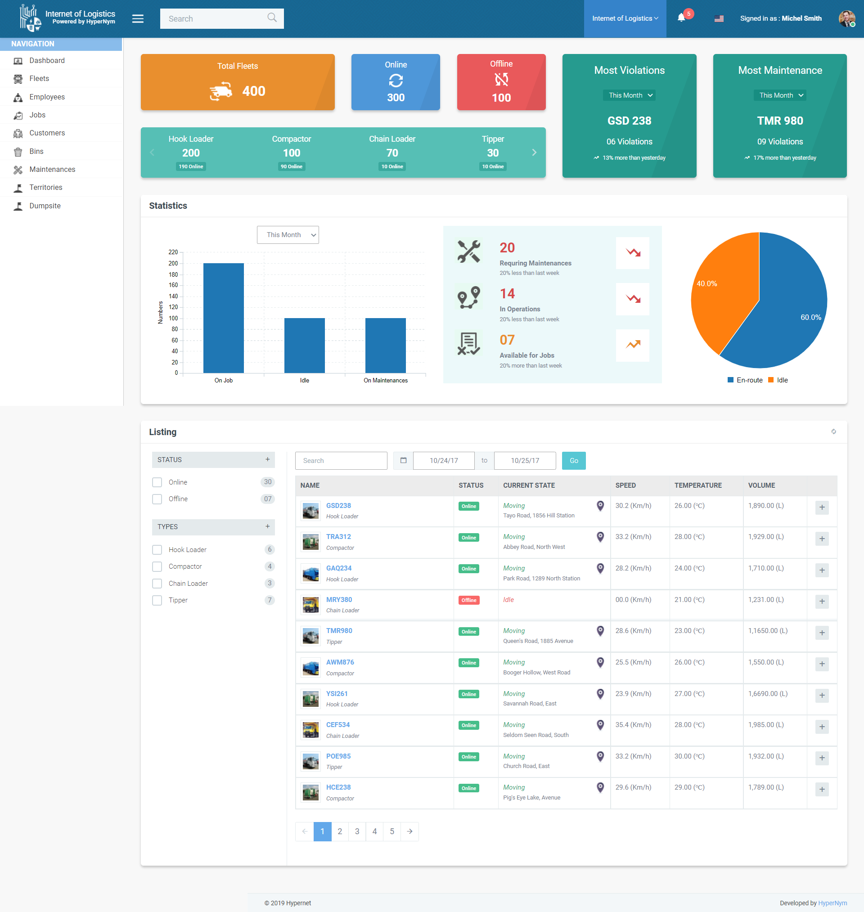
Top-View Dashboards

Slide 19
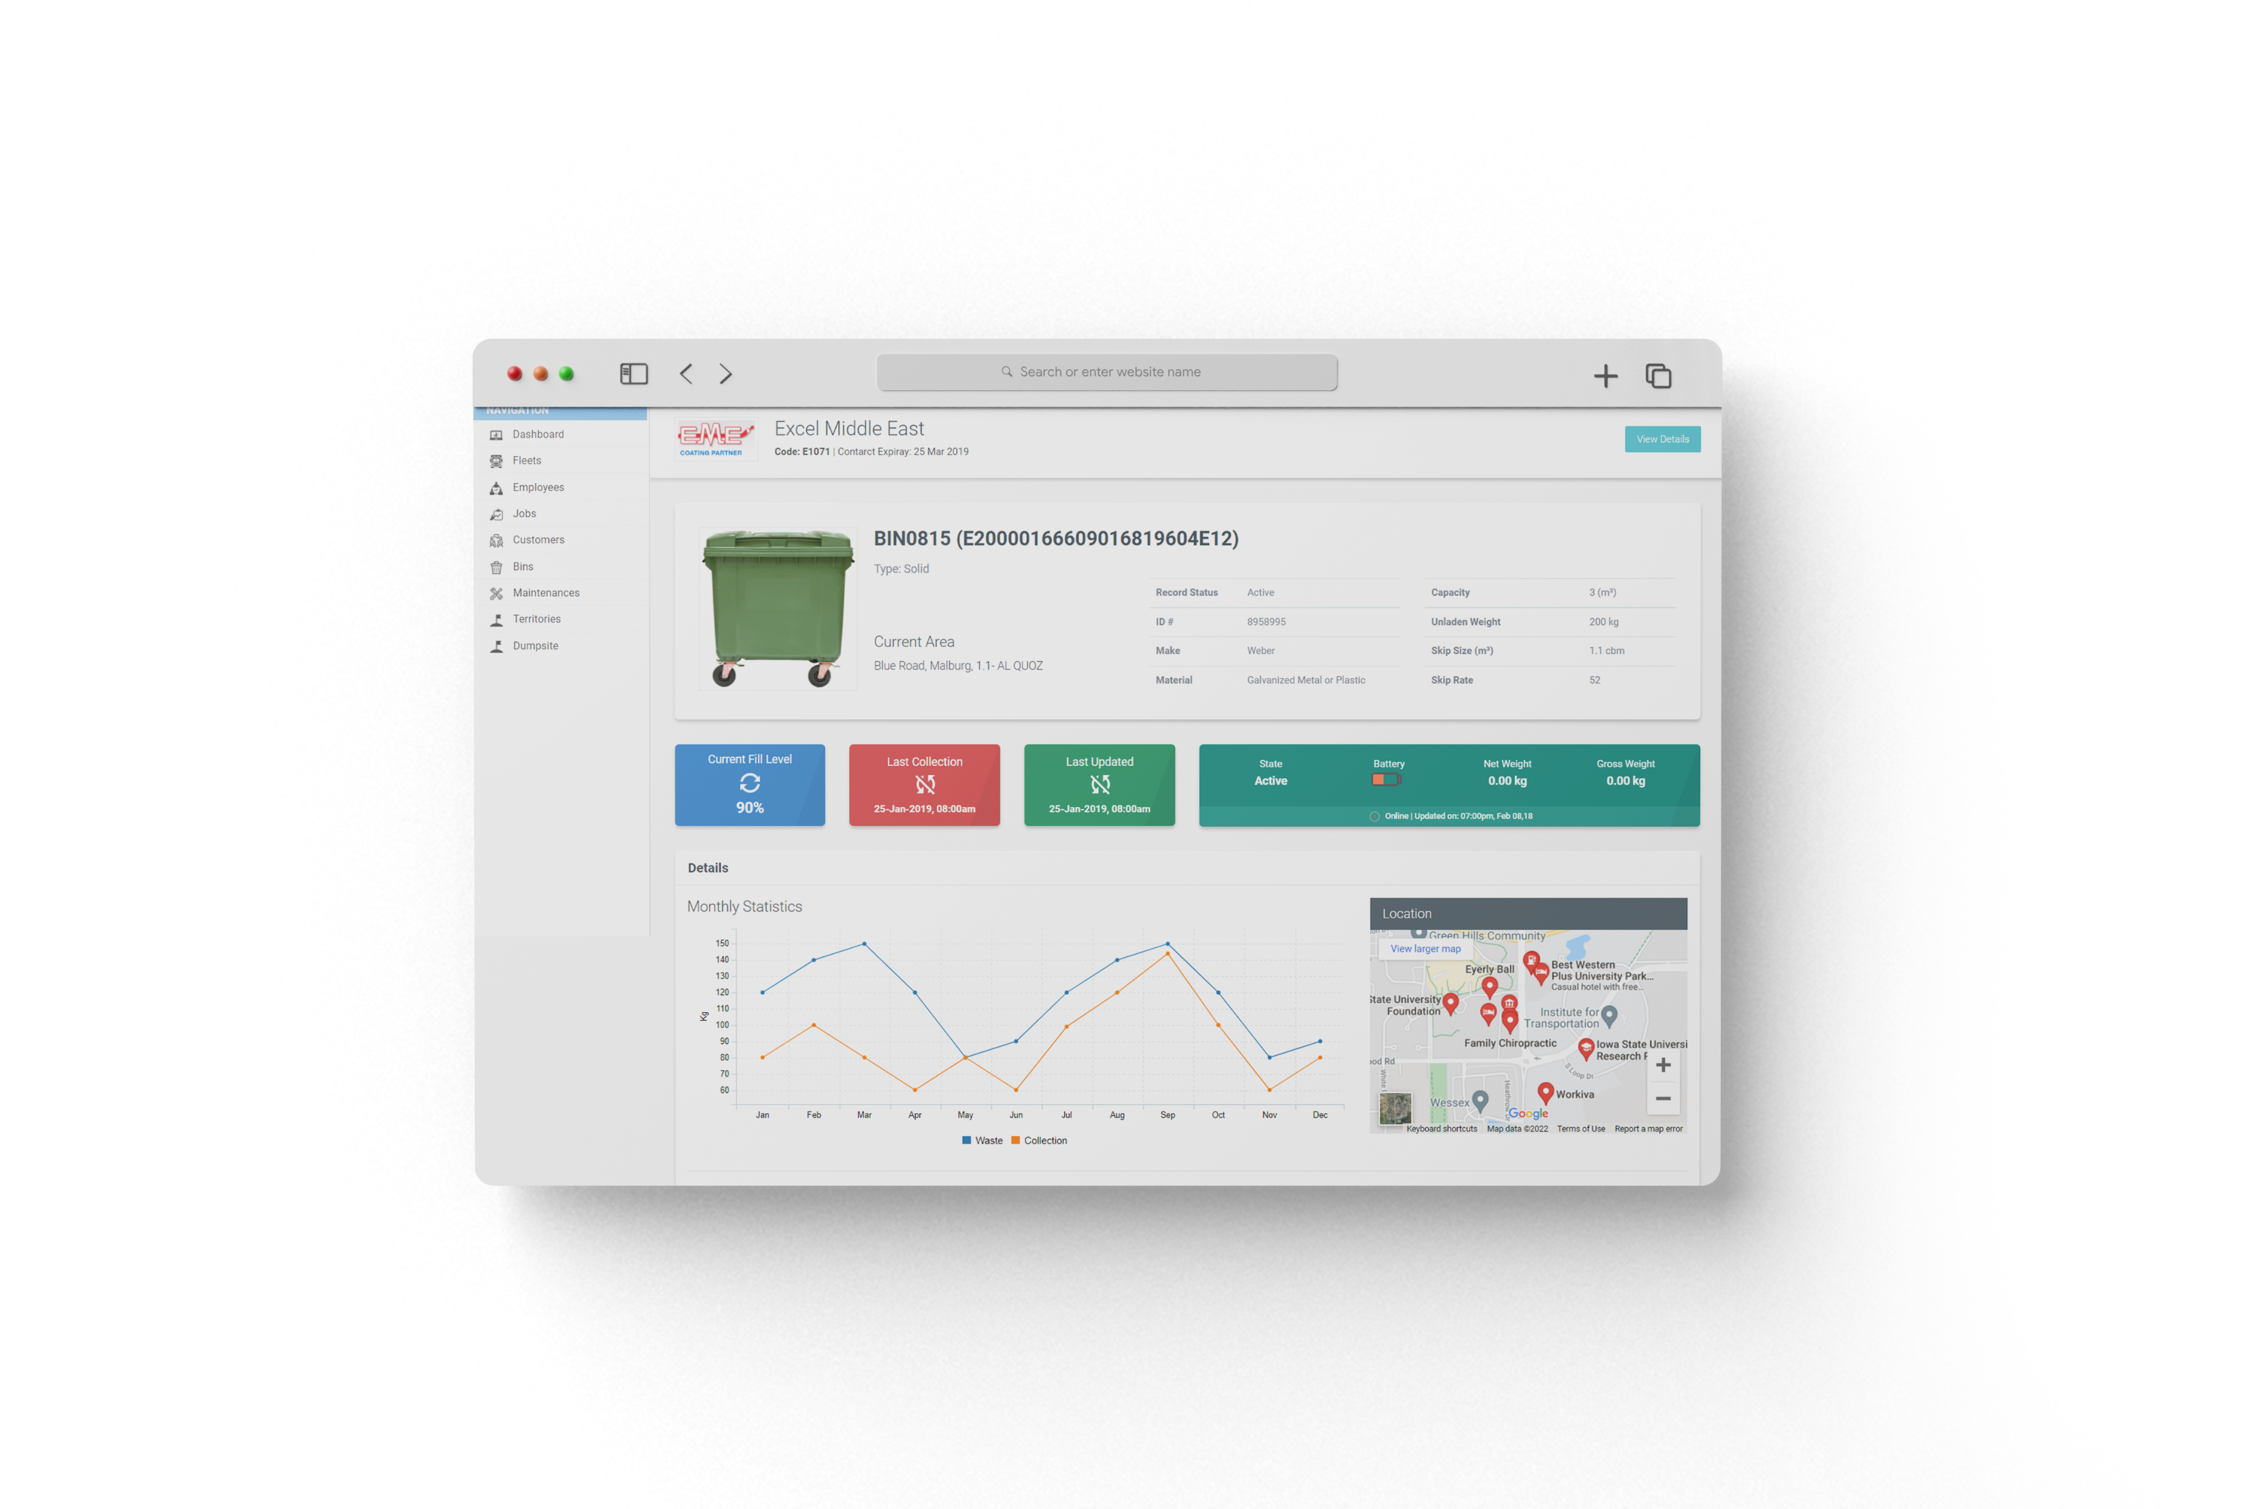
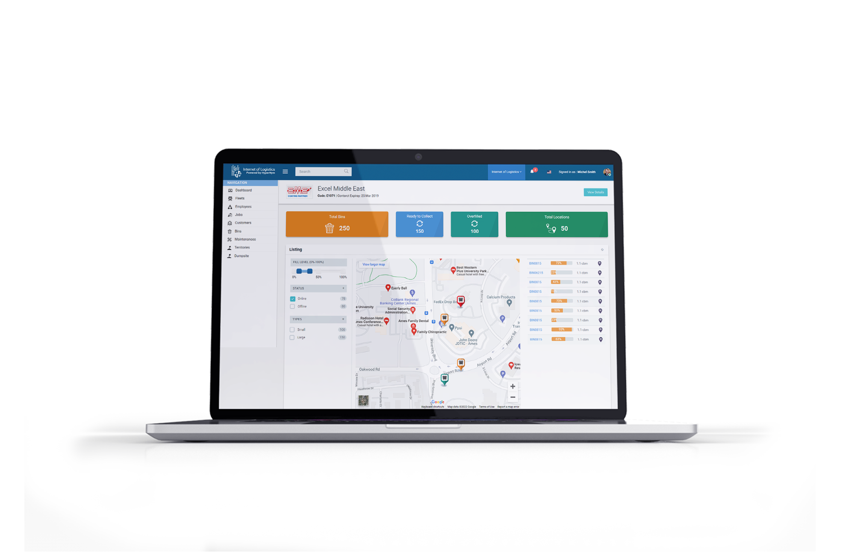
Fleet & Waste Bins Management
Customer Management

Slide 20
National Supply &
Demand (B2B)

Slide 21
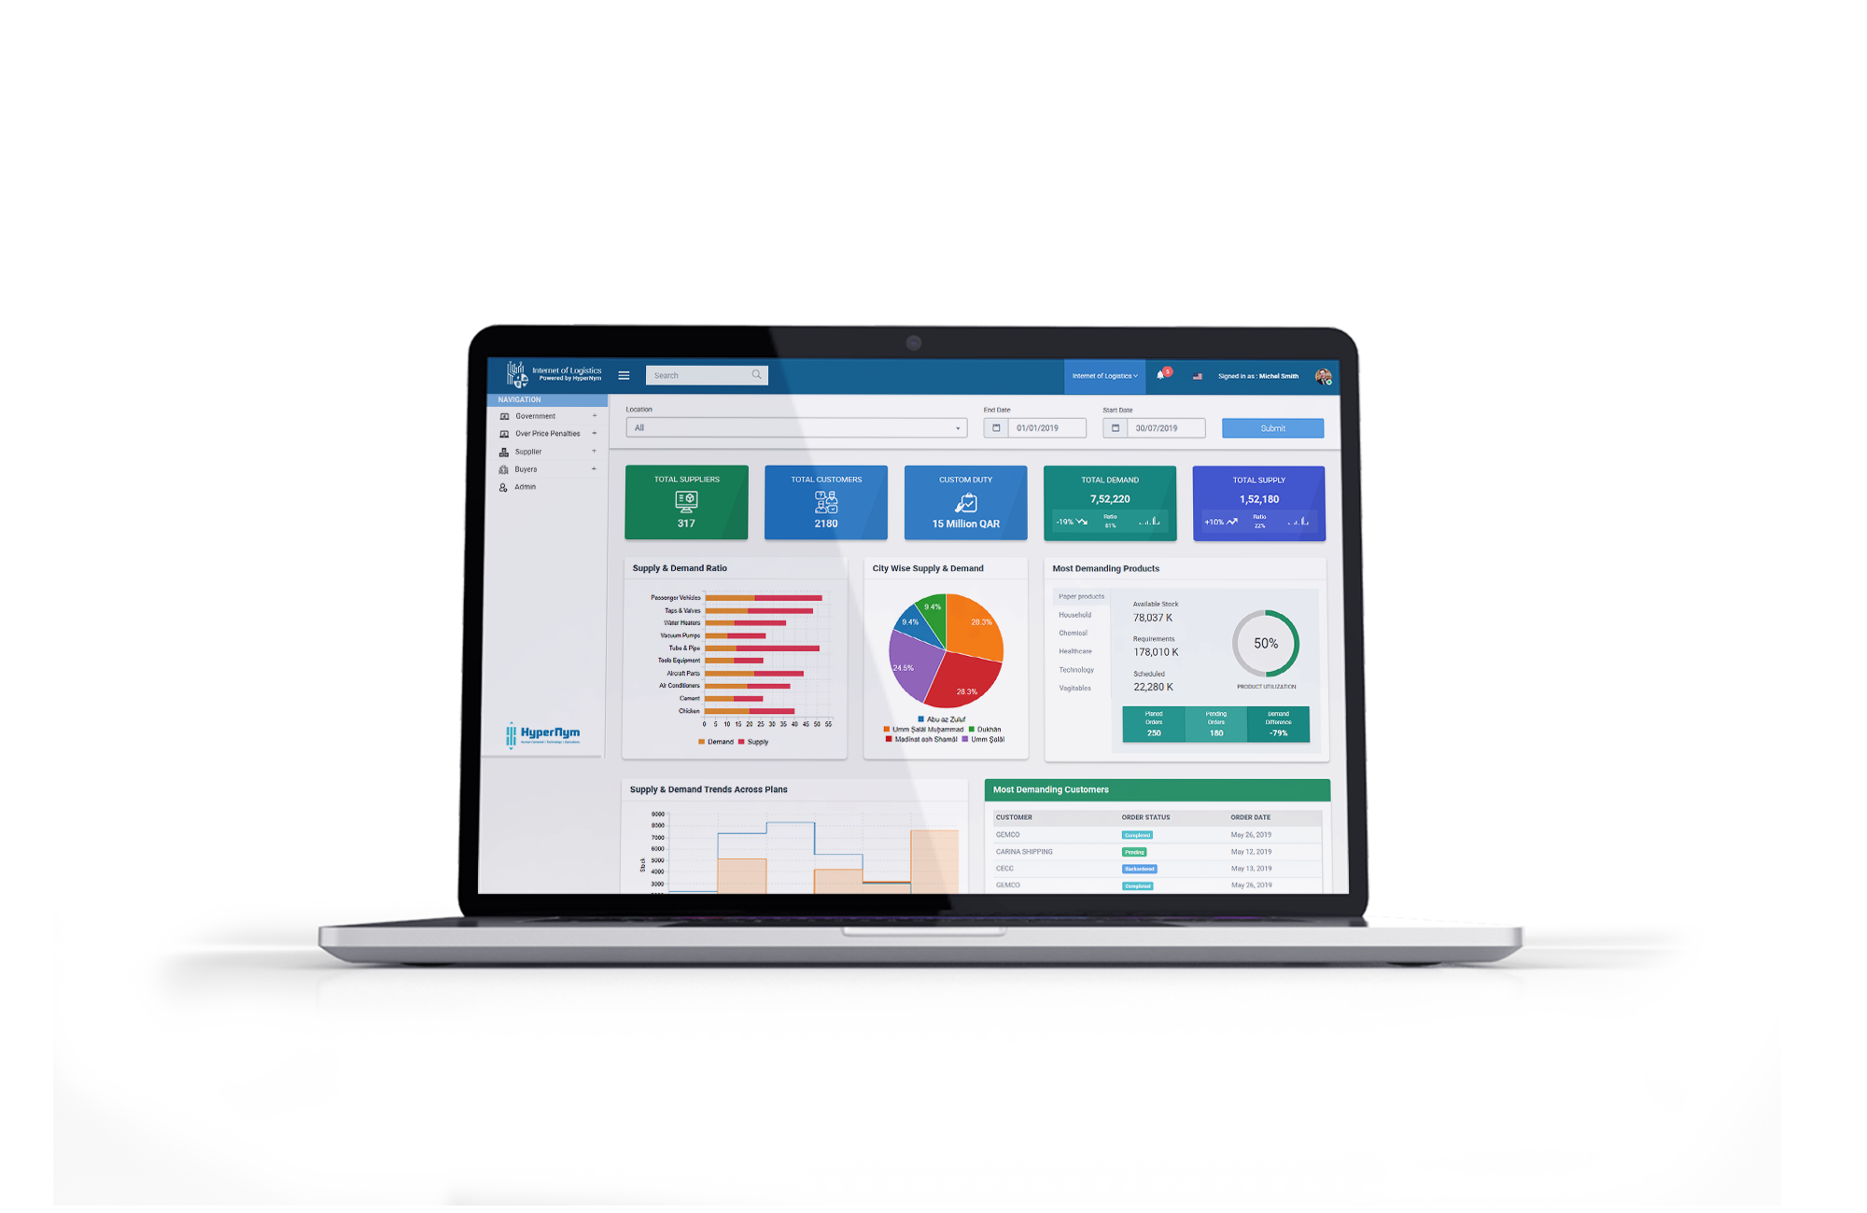
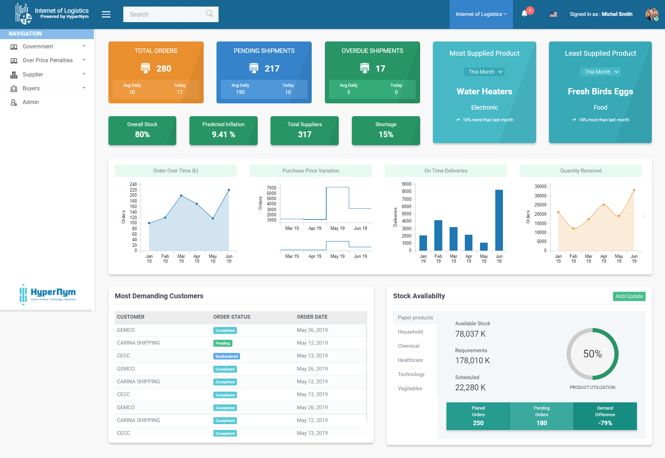
Supplier View
Business Order-Dashboards

Slide 22
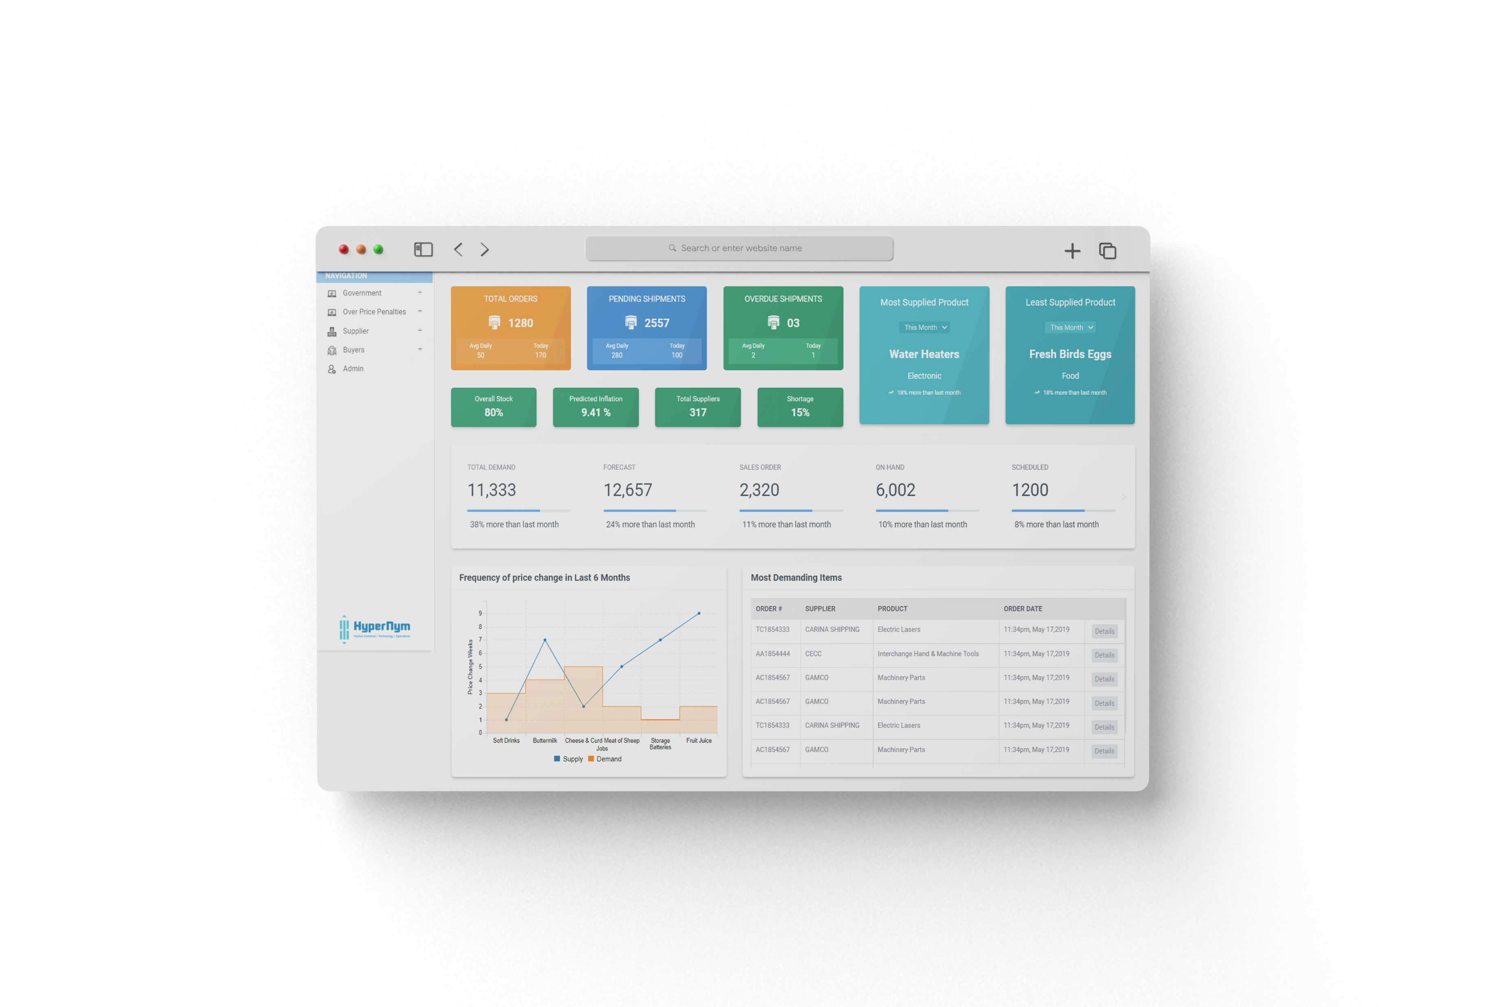
Buyer Analysis

Slide 23
Field Force Performance

Slide 24
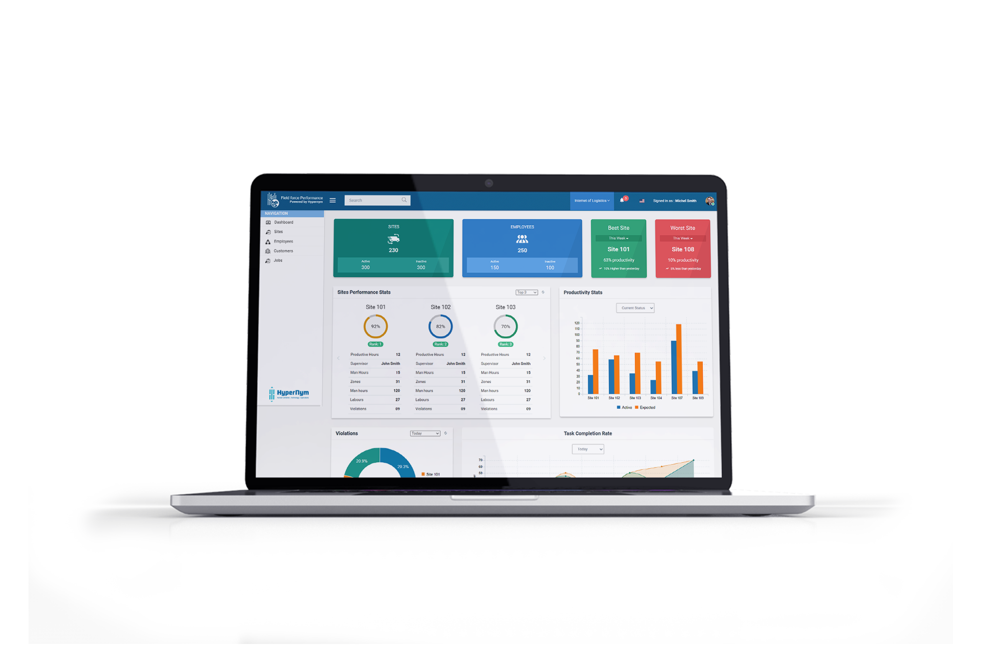
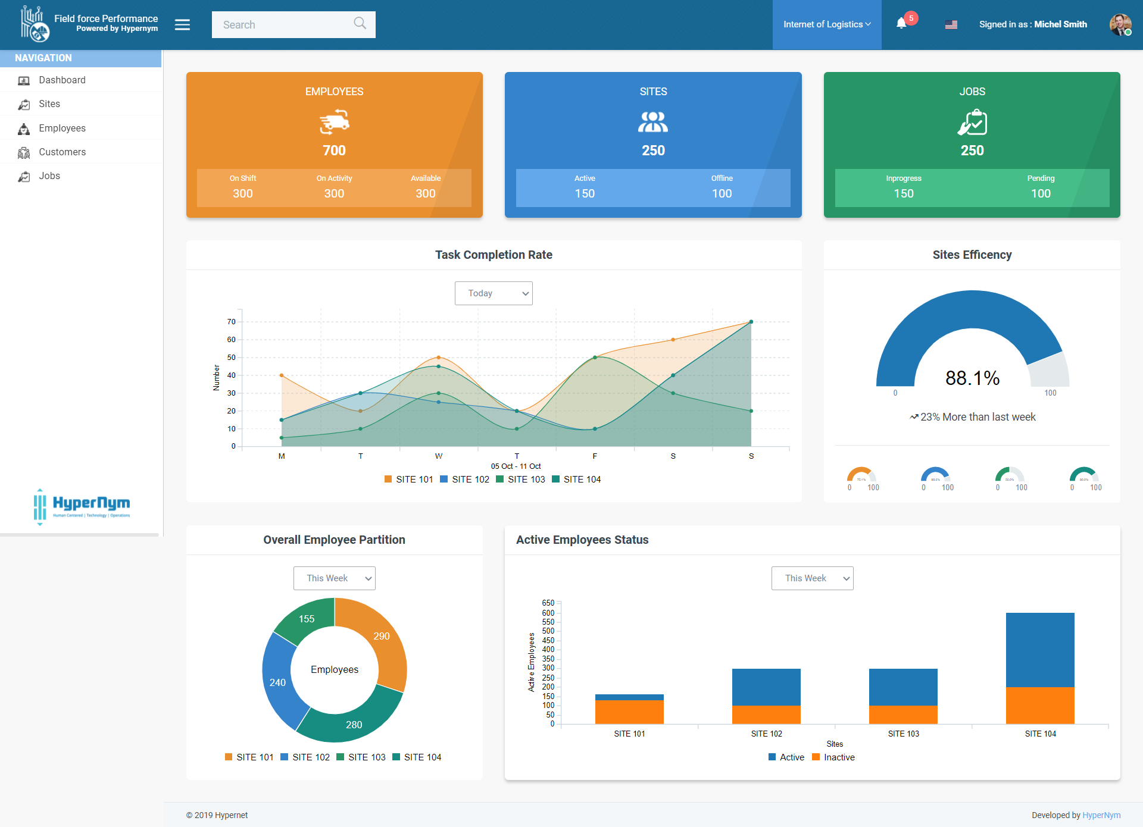
Sites
Management
Staff Management

Slide 25
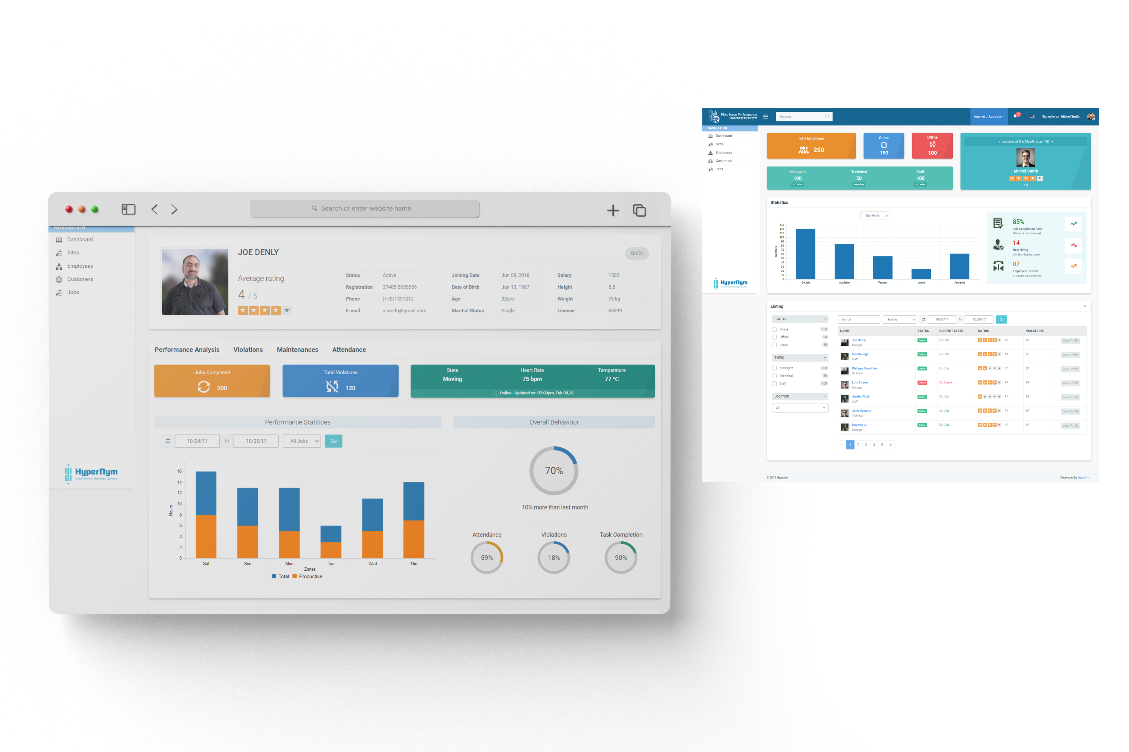
Employee Work Analysis

Slide 26
Your Partner in Digitization

